Slide 1
Acceleration Pathways
Common Core Mathematics
Diana Kolhoff
Mathematics Education Consultant, Long Island
www.mathampton.com

Slide 2
Why do we accelerate?
Pathway to Advanced Mathematics
Parental Request ~ “Honors”
Part 100.4 of NYSED Regulations
Increase Graduation Rate
International Baccalaureate
Appropriate for the Student

Slide 3
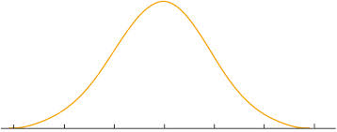
Who do we accelerate?
LD – Low Achieving – On Level – High Achieving – Gifted
Notes:
Research on hetero vs homogeneous grouping

Slide 4
Who do we accelerate?
Screening Policy:
Common Assessment
NYS Assessments
Grade History
Teacher Recommendations
Parent Involvement

Slide 5
When do we accelerate?
At what grade is the decision made?
Is there ability grouping prior to decision point?
What if we make the wrong decision?
Accelerate when Inappropriate
Discouraged Students
Must Repeat
Slows Down the Class
Don’t Accelerate when Appropriate
Missed Opportunity for Student
Difficult to Get Back on Track
Notes:
When do we accelerate?

Slide 6
Was it working?
Elaine Zseller, Ph.D
Program Supervisor
Data Analysis and Curriculum Support
Nassau BOCES
Notes:
When do we accelerate?

Slide 7
Was it working?
Level 2 Students were more successful in Integrated Algebra in a Traditional Program than in an Accelerated Program
2012 Integrated Algebra Success Rates By Grade Seven Year
Grade 7 Level | 7th in 2009 Extended Students | 7th in 2010 Traditional Students | 7th in 2011 Accelerated Students
1 |  | 28.1% | 28.6%
2L | 25.8% | 55.5% | 43.1%
2H | 46.9% | 80.4% | 70.4%
3L | 65.9% | 91.6% | 91.2%
3H | 87.0% | 97.2% | 98.2%
4L | 99.7% | 99.6% | 100%
4H
Notes:
When do we accelerate?

Slide 8
Was it working?
Students Who Scored Level 1 or Level 2L in Grade 7
Did NOT Take Geometry as Accelerated Students
2013 Geometry Success Rates By Grade Seven Year
Grade 7 Level | 7th in 2009 Extended Students | 7th in 2010 Traditional Students | 7th in 2011 Accelerated Students
1
2L |  | 47.4%
2H |  | 65.4% | 63.5%
3L | 55.3% | 85.8% | 83.7%
3H | 79.2% | 93.3% | 94.3%
4L | 97.4% | 98.1% | 99.4%
4H |  |  | 100%
Notes:
When do we accelerate?

Slide 9
Was it working?
Students in an Accelerated Program are not as Successful as Students in a Traditional Program in Algebra II/Trig
2014 Algebra II / Trig Success Rates by Grade 7 Year
Grade 7 Level | 2009 Extended Students | 2010 Traditional Students | 2011 Accelerated Students
1
2L |  | 40.5%
2H |  | 56.7% | 37.3%
3L |  | 68.6% | 59.7%
3H |  | 78.6% | 77.9%
4L |  | 88.2% | 94.8%
4H |  |  | 100%
Notes:
When do we accelerate?

Slide 10
Traditional acceleration:
A Brief History:
Districts had increasingly offered Algebra in Grade 8.
The Common Core Learning Standards have a tight progression of standards, without redundancy in grade 8.

Slide 11
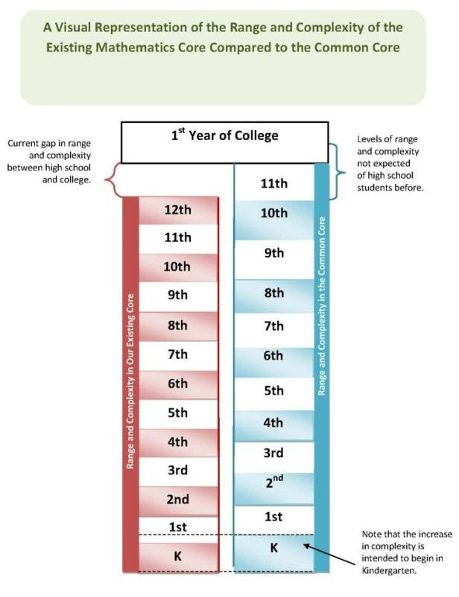
A Shift:
Notes:
I found this graphic in a Utah State publication, but it applies to us as well. On the left, the pink represents the range and complexity of the 2005 standards. Notice the gap between 12th year and college. One interesting statistic in NY is that 65% of college incoming freshmen require remediation, and 75% of our students that would like to join the armed services can’t pass the entrance exam for mathematics. Common Core State Standard is addressing this gap as represented by the blue column. I think this is a nice visual to show the increased levels of complexity at every grade level. Notice that college coursework on the right is now after grade 11, and the increased complexity starts in Kindergarten.
I have done a lot of professional development at the elementary school level, and I can vouch for the shift that teachers and students are feeling at every grade level k-5. We must be sensitive to the transitional period here as kids shift from one lane to the other. In grade 5 common core, there is an assumption that students have hade rich common core experiences k-4.

Slide 12
2005 Algebra 2/Trig Standards – Moved!
P and C, Trig
Rational and Irrational Expressions
Logarithms and e,
Trigonometry
Circles, Triangle Trig
Sequences, Functions, Quadratics
Expon/Rads, Statistics
De-Emphasized

Slide 13
Integrated Algebra – Where did it go?
Rational Expressions
Sets
Triangle Trig
Quadratics
Linear Algebra
Bivariate Stats
Expressions, Equations, Inequalities, Prob/Stats

Slide 14
Common Core Grade 8 – What is it?

Slide 15
CCSSI: Appendix A “Compacted”
1. Compacted courses should include the same Common Core State Standards as the non-compacted courses.
2. Decisions to accelerate students into the Common Core State Standards for high school mathematics before ninth grade should not be rushed.
3. Decisions to accelerate students into high school mathematics before ninth grade should be based on solid evidence of student learning.
4. A menu of challenging options should be available for students after their third year of mathematics—and all students should be strongly encouraged to take mathematics in all years of high school.
6 | 7/8 | 8/A1 | G | A2 | PC | AP
APPR and the Grade 8 waiver create challenges in NYS.
Notes:
The only guidance we have……

Slide 16
Current practice in the field
Acceleration Model
based on 2005 Standards
ACCELERATED TRACK
6 | 7 | A1 | G | A2 | PC | AP
Grade 8 standards may not be adequately addressed

Slide 17
Common Core Learning Standards

Slide 18
Common Core Learning Standards

Slide 19
But Why Calculus?
Mathematical Association of America and the National Council of Teachers of Mathematics have taken the position that the goal of a K-12 mathematics curriculum shouldn't be to get students through calculus but to give students a strong foundation in mathematics that will prepare them for a range of college majors.

Slide 20
Best Pathways to AP Courses
GRADE
6 | 7 | 8 | 9 | 10 | 11 | 12
FOR ALL – COLLEGE AND CAREER
6 | 7 | 8 | A1 | G | A2 | PC or AP
HIGH ACHIEVER - ENRICHMENT
6H | 7H | 8H | A1H | GH | A2H | AP
CONCURRENTLY – A2/PC and STATS
STAT
6 | 7 | 8 | A1 | G | A2/PC | AP
CONCURRENTLY – DOUBLE UP
AP Stats
6 | 7 | 8 | A1 | G | A2/PC | AP

Slide 21
Best Compacted: High School
GRADE
6 | 7 | 8 | 9 | 10 | 11 | 12
3.5 Years in 3 : No Extra Time
6 | 7 | 8 | A1+ | G+ | A2+ | AP
2.5 Years in 2 : 1.5 Time in 11 or 12
6 | 7 | 8 | A1 | G+ | A2+ | AP
2 Years in 1 : Double Time in 12
PC
6 | 7 | 8 | A1 | G | A2 | AP
Concurrently : Double Up
G
6 | 7 | 8 | A1 | A2 | PC | AP

Slide 22
Compacted Middle School
GRADE
6 | 7 | 8 | 9 | 10 | 11 | 12
4 YEARS IN 3 – 1.5 TIME IN 7 OR 8
6/7 | 7/8 | 8/A1 | G | A2 | PC | AP
3 YEARS IN 2 – 1.5 TIME IN 7 AND 8
6 | 7/8 | 8/A1 | G | A2 | PC | AP
5 YEARS IN 4 – NO EXTRA TIME
6/7 | 7/8 | 8/A1 | 8/G | A2 | PC | AP
4 YEARS IN 3 – 1.5 TIME IN GRADE 8
6 | 7/8 | 8/A1 | 8/G | A2 | PC | AP

Slide 23
Why do we accelerate?
Pathway to Advanced Mathematics
Parental Request ~ “Honors”
Part 100.4 of NYSED Regulations
Increase Graduation Rate
International Baccalaureate
Appropriate for the Student

Slide 24
Accelerate the Conversation… Enrich the Curriculum
Honors Courses:
Increase expectations and rigor
Increase complexity and modeling
Allow time for projects
All students take same State Exam

Slide 25
NYSED PART 100.4
d. Grade eight acceleration for diploma credit.
1. Public school students in grade eight shall have the opportunity to take high school courses in mathematics and in at least one of the following areas: English, social studies, languages other than English, art, music, career and technical education subjects or science courses.
3. Such opportunity shall be provided subject to the following conditions: The superintendent, or his or her designee, shall determine whether a student has demonstrated readiness in each subject in which he or she asks to begin high school courses in the eighth grade leading to a diploma.

Slide 26
NYSED PART 100.4
The Regulation calls for the opportunity to be accelerated in Math and at least one other subject, however the determination of readiness for acceleration is made by the superintendent. If a student has mastered the intermediate (Gr 5-8) Math Standards, and a determination (using a consistently applied local policy) is made that a particular student would benefit from acceleration, AND the student asks to be accelerated, then the district must offer the opportunity. If the above does not happen, then it is conceivable that there may not be middle level students who demonstrate readiness for high school course work in a particular school or district. There is no mandate to provide acceleration if the district concludes that this is the case.

Slide 27
Best Pathways to AP Courses
GRADE
6 | 7 | 8 | 9 | 10 | 11 | 12
FOR ALL – COLLEGE AND CAREER
6 | 7 | 8 | A1 | G | A2 | PC or AP
HIGH ACHIEVER - ENRICHMENT
6H | 7H | 8H | A1H | GH | A2H | AP
CONCURRENTLY – A2/PC and STATS
STAT
6 | 7 | 8 | A1 | G | A2/PC | AP
CONCURRENTLY – DOUBLE UP
AP Stats
6 | 7 | 8 | A1 | G | A2/PC | AP

Slide 28
Diana Kolhoff
Mathematics Education Consultant, Long Island
www.mathampton.com
mathampton@gmail.com

