Slide 1
LONG Island Association for Supervision and Curriculum Development Legal Update for Administrators
Presented by:
Erin M. O’Grady-Parent, Esq. & Lisa l. Hutchinson, esq.
October 4, 2019
24 century hill drive 77 Conklin street
Latham, new York 12110 farmingdale, new York 11735
(518) 690-7000 (516) 694-3000

Slide 2
Legal Developments
Significant Developments from
The Courts
Commissioner of Education
Administrative Agencies
State and Federal Guidance
The Legislature (statutes)
The Board of Regents (regulations)

Slide 3
Student Rights and issues

Slide 4
Immunization
State of the law pre-June 13, 2019:
Public Health Law §2164 required children between the ages of 2 months and 18 years to be immunized against certain diseases, and children without proof of those immunizations could not attend school for more than 14 days after enrollment absent proof of immunization, unless they obtained a medical or religious exemption.
Principal could grant a religious exemption upon a showing by the parent/guardian that a sincerely held religious belief prohibited vaccinations.
Chapter 35 of the Laws of 2019, effective June 13, 2019, eliminated the religious exemption.
Medical exemption is not affected by new law—still viable.
To date, lawsuits challenging Chapter 35 and the repeal of the religious exemption have not been successful in overturning the repeal and/or delaying implementation of the law.

Slide 5
IMMUNIZATION
Immunization requirements apply to:
students attending public, private and charter schools
students receiving homebound instruction
homeschooled students wishing to take exams at school or participate in sports or classes at school
students who are transported on school buses
homeschooled special education students who are receiving some part of their program/services at a public, private or parochial school
Immunization requirements do not apply to:
activities on school property that are open to the general public (e.g., spectating sporting events, student plays, etc.) in which the student participates in his/her capacity as a private citizen
homeschooled students
Students 18 years of age or older

Slide 6
IMMUNIZATION
SED/DOH/OCFS guidance of June 18, 2019 and July 18, 2019:
Every student with a prior religious exemption who is attending year-round school (summer school or ESY) must have received the first age-appropriate vaccine by June 28, 2019 to attend/remain in school, and by July 14, 2019 parents/guardians must show that they have made appointments for all required follow-up doses.
For students who did not attend summer school or ESY, proof of immunization to be provided within 14 days after the fist day of instruction in September; 14 days may be extended if the student is transferring from out-of-state or another country and shows a good faith effort to get the necessary evidence of vaccination or where child has received the first age-appropriate dose in each immunization series within the 14 days and the parent/guardian shows evidence of age-appropriate scheduled appointments for follow-up doses to complete the immunization series.

Slide 7
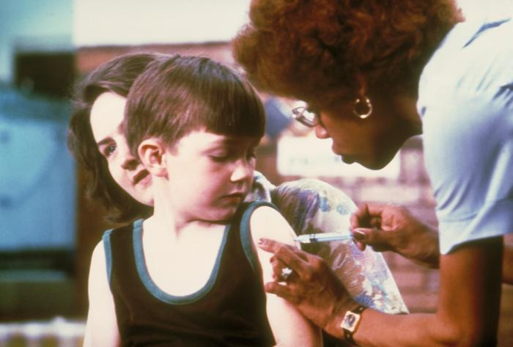
IMMUNIZATION
On August 16, 2019, DOH issued emergency regulations and SED/DOH/OCFS issued additional joint guidance.
Clarified and restated that students must meet one of three immunization requirements to attend school:
show proof that the student is “fully immunized” from 8 communicable diseases; or
show proof that the student is in process of receiving immunizations against each of those diseases; or
provide a medical exemption signed by a physician licensed in NYS.
Strengthened requirements for obtaining a medical exemption.

Slide 8
immunization
Under DOH regulations, a student is “fully immunized” when there is age-appropriate compliance with the immunization schedule publishes by the CDC’s Advisory Committee on Immunization Practices (ACIP).
https://www.cdc.gov/vaccines/schedules/hcp/index.html
A student is “in process” if he/she: has received the first dose of vaccine in each required immunization series; and has made age-appropriate appointments to obtain the remaining doses in each series , under the ACIP schedule.
if a child does not receive subsequent doses of the vaccine in an immunization series according to the age-appropriate catch-up schedule, including at appropriate intervals, the child will be considered to no longer be “in process” and must be excluded within 14 days of the missed dose.

Slide 9
immunization
Consequences of failure to immunize:
Exclusion from school
Per SED Guidance, where more than 14 days have passed since a child has been excluded from school and the parent/guardian has refused to allow immunization, the school must notify CPS, unless the parent/guardian has advised that steps are being taken toward home schooling or another education option.

Slide 10
Discrimination, Bullying and Harassment
The State Human Rights Law was amended, effective July 25, 2019, to expand the definition of “educational institution” to include school districts and BOCES. This change enables public school students to file claims of discrimination, bullying and harassment against public school districts with the State Division of Human Rights and to provide such students with the opportunity to receive monetary compensation for harm done to them by virtue of such discrimination and harassment. (Chapter 118 of the Laws of 2019)

Slide 11
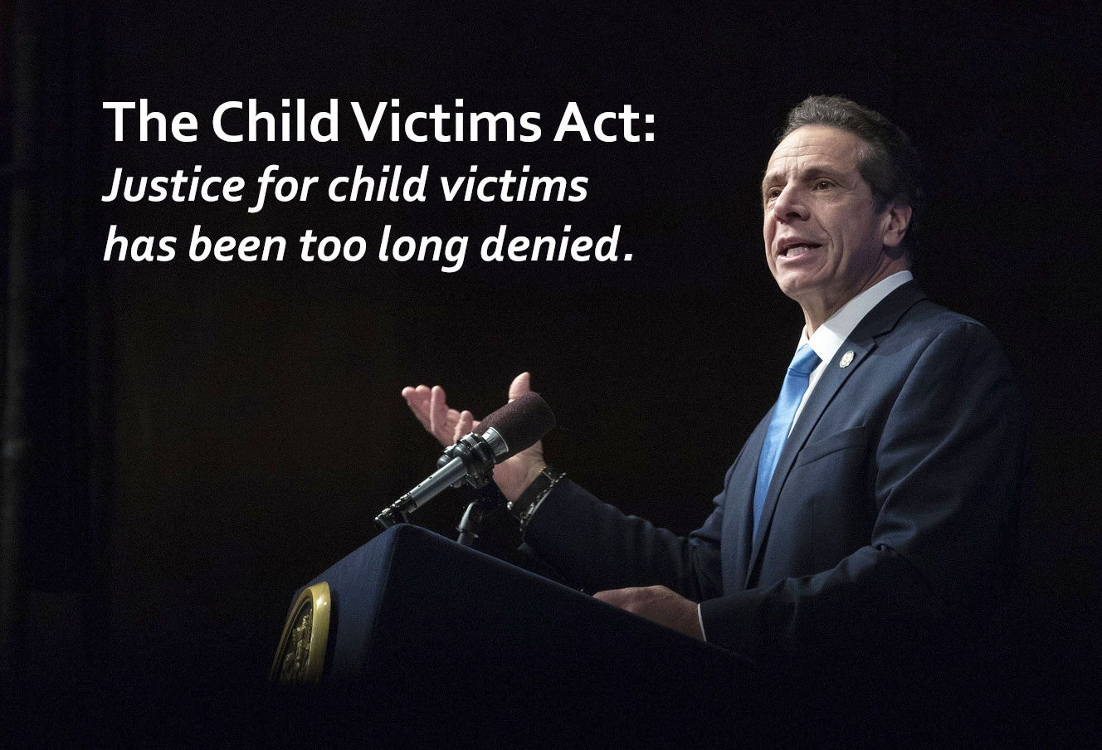
Child victims act
Signed into law on February 14, 2019 (Chapter 11 of the Laws of 2019).
Statute of limitations reform for sex abuse cases -- allows individuals who suffered sexual abuse as children to file civil lawsuits up until the time the victim turns 55 years old.
Previous law: required victims to initiate any civil lawsuit for sex abuse before their 23rd birthday.
The law also contains a one-time “look-back” period that begins on August 14, 2019, which allows victims to file lawsuits during a one-year period no matter how long ago the abuse occurred; revives old cases for which SOL had passed.
Applies to any institution that serves children, including schools.

Slide 12
CHILD VICTIMS ACT
Under “look-back”, former students may now assert complaints of sexual assault that were not previously made, and courts will be required to hear those claims.
Victim can win damages by showing the district was indifferent to the abuse and negligently retained or supervised the employee.
Burden of proof is a preponderance of the evidence, and there is no cap on damages.
Unlike other civil suits against school districts, the filing of a notice of claim is not a prerequisite to bringing suit.

Slide 13
Red flag law
Chapter 19 of the Laws of 2019, effective August 24, 2019.
Permits courts to issue “extreme risk protection orders” (ERPO) prohibiting certain individuals from buying, possessing or trying to buy any type of gun.
Applications are voluntary—not mandatory.
The extent to which an applicant will be protected from liability for making reports is unclear.

Slide 14
Red Flag Law
Who can apply for the ERPO?
Building principal or equivalent title in the building the student currently attends or has attended in previous six months.
Other staff in the building designated in writing by the administrator and working in the same building as the administrator.
“Designees” may be teachers, guidance counselors, school psychologists, school social workers, school nurses, or other staff required to hold a teaching or administrator license or certificate, or compensated coach who holds a coaching license or professional coaching certificate.

Slide 15
RED FLAG Law
Application requirements:
Sworn statement
Describe facts that underly belief the student poses a risk
State whether individual is known to own, possess or have access to guns
Judge must review on the same day application is submitted and consider factors set out in the law (e.g., threats, use of physical force, violations of orders of protection, existence pending charges, attempts to purchase a gun, etc.)
Court can issue an immediate temporary ERPO, which will impose limits on ability to possess/buy guns, adds name to FBI background check database, suspend existing gun permits, etc.; formal ERPO hearing to follow, at which student can put on a defense.

Slide 16
Child abuse in an educational setting
Article 23-B of the Education Law was amended, effective June 5, 2019, to expand the list of professionals who are mandated reporters to include licensed and registered physical therapists, licensed and registered occupational therapists, licensed and registered speech-language pathologists, teacher aides, school resource officers, and employees of bus companies that contract with schools to provide transportation, including bus drivers (Chapter 363 of the Laws of 2018).
Article 23-B was further amended by Chapter 164 of the Laws of 2019 to clarify that school bus drivers employed by a school are also required to report.
All mandated reporters must complete training regarding identification and reporting of abuse.

Slide 17
Student records
State Budget legislation (Chapter 59 of the Laws of 2019) made permanent the provisions of law that prohibited the State 3-8 ELA and Math assessment scores from being included on a student’s permanent record. Ch. 56 of the Laws of 2014, Part AA, Subpart B, Section 2, as amended by Ch. 59 of the Laws of 2018, Part CCC, Section 35.

Slide 18
Data Privacy
The State Education Department has proposed regulations relating to the protection of the privacy and security of personally identifiable information (PII) of students (as well as the APPR data of teachers and principals) to implement the provisions of Education Law §2-d which was added by Chapter 56 of the Laws of 2014, effective April 2014.
Among other things, the proposed regulations are intended to clarify: the complaint and reporting requirements; the use or disclosure of PII by third party contractors; and the requirements of the required data security and privacy plan. The proposed regulations would give school districts until July 1, 2020 to adopt and publish a data security and privacy plan.
The proposed regulations are currently scheduled for adoption at the October Regents meeting.

Slide 19
Foster care Tuition
In the Appeal of the Bd. of Educ. Menands UFSD, Decision No. 17,713 (7/26/19), the Commissioner of Education sustained the petitioner school district’s appeal contesting fiscal responsibility for tuition costs for a student in foster care who was being educated by another school district.
In that case the student’s only connection to the petitioner school district was his brief temporary stay in a homeless shelter located in the district before entering foster care.
The Commissioner held that the petitioner district could not be considered the “district of residence” under Education Law §3202(4) (now referred to in the statute as “district of origin”) because his temporary placement in the shelter did not establish residence in petitioner district.

Slide 20
Foster care tuition
In addition, the Commissioner found that there was no evidence that respondent County Department of Social Services (DCYF) met its obligations under Education Law §3202(4)(f).
Specifically, it was clear from the record that respondent DCYF failed to generate the required LDSS-2999 form for over a year until prompted to do so by the respondent school district that provided education to the student, failed to notify petitioner district that it had been designated as the school district of residence at any time, and failed to make a final determination in a timely manner after petitioner objected to the designation, all in direct violation of its obligations under Education Law §3202(4)(f).
Accordingly, the Commissioner assigned fiscal responsibility to DCYF during the pendency of the appeal and ordered DCYF to pay the student’s tuition costs from September 2017 to the date of the Commissioner’s decision.

Slide 21
Academic integrity
In two decisions, the Commissioner upheld the actions a school district took in response to student cheating on exams.
In Appeal of L.M., Decision No. 17,561 (December 21, 2018) and Appeal of S.B., Decision No. 17,563 (December 21, 2018), petitioners challenged grades of zero awarded after an investigation revealed cheating on a physics exam.

Slide 22
ACADEMIC integrity
Investigation showed a teacher’s secure files were breached by a former student who sold a flash drive with the 2015 test answers to two current students, who emailed it to other students. The 2015 exam was identical to the exam administered.
The 2 students received a grade of zero on the midterm and a second quarter grade of 50, as per district policy; the student who purchased the material was also suspended.
Commissioner rejected arguments that: (1) §3214 due process was not provided, holding that §3214 applies only to suspensions, not academic consequences; (2) the students lacked notice of what constitutes cheating because the code of conduct did not contain an example that involved receipt of materials before a test; (3) the students did not know that the test they were about to take was the same as the 2015 test they stole.

Slide 23
Student discipline
Appeal of a Student With a Disability, Dec. No. 17,610 (2019) – Commissioner upheld a one month suspension for an electronic posting on Snapchat.
Posting was a picture of another student in front of a rack of mounted paintball guns with the caption: “Don’t come to school on Tuesday”.
Student said it was intended as a joke (and police found that it was).
Commissioner rejected student’s argument that he could not be disciplined because he uploaded the post off school grounds and during non-school hours.
“A threatening posting that triggers an investigation by school authorities and the police, and a security sweep of the school, and the issuance of an explanatory message from the superintendent to the community clearly involves a material interference with the operation of the school.”
Short-term suspension expunged for lack of proper notice; circumstances did not justify use of continuing danger or ongoing threat of disruption exception.

Slide 24
Student discipline
Appeal of a Student With a Disability, Dec. No. 17,600 (2019) – Commissioner found that a board of education erred when it found a student guilty of a materially different charge that the district did not raise at, or prior to, the long-term suspension hearing.
Student was charged with and found guilty after a superintendent’s hearing of use of an illegal controlled substance on school grounds. Student appealed to the BOE.
The BOE threw out the finding of guilt and found the student guilty of a different infraction – possessing a vape pen on school grounds. Student appealed to Commissioner.
Commissioner: The material modification of the charge violated the rights of the student to a fair hearing. Long-term suspension annulled and record expunged (short-term suspension also expunged for lack of proper notice).

Slide 25
SED and OAG Joint Guidance
On August 29, 2019, SED and OAG issued joint guidance to school districts clarifying the role of SROs in safeguarding the rights of all students, including undocumented students, to receive a public education without fear of intervention by Immigration and Customs Enforcement (ICE) agents.
On the same day, SED and OAG issued joint guidance to school districts to clarify the obligations of districts to administer student discipline policies and practices in a way that ensures every student has access to a safe and supportive learning environment, free from harassment, bias and discrimination.

Slide 26
Curriculum and Instruction

Slide 27
Instruction on the Prevention of Child Sexual Exploitation and Child Sexual Abuse
Chapter 187 of the Laws of 2019 enacts “Erin’s Law”. Law takes effect July 1, 2020.
Requires all pupils in grades K-8 in the State’s public schools to receive instruction designed to prevent child sexual exploitation and child sexual abuse. Program shall be defined by the Commissioner of Education, after consultation with the Department of Health.
Commissioner may make model curricula and resource materials available on its website and may provide technical assistance to facilitate the development of age appropriate curricula designed to provide awareness, skills, information, self-confidence and support to aid in the prevention of child exploitation and child sexual abuse.

Slide 28
Information on Concussions
Effective December 2, 2019, Chapter 243 of the Laws of 2019, amends the Public Health Law to require all tackle football programs in the State, including any program organized by a school, to provide to parents/guardians of children participating in the program and informational packet about concussions and sub-concussive blows, and the injuries that might result from such blows. DOH is directed to provide the informational packet and make it available for download free of charge from DOH’s website.

Slide 29
9/11 Remembrance Day
Chapter 248 of the Laws of 2019 amends the Education Law to direct the Commissioner of Education to provide for the observance of September 11th Remembrance Day in public schools.
The Commissioner of Education is mandated to make special provision for the observance of a brief period of silence for September 11th Remembrance Day.

Slide 30
Labor relations and EMPLOYMENT ISSUES

Slide 31
New Workplace Harassment Protections
On August 12, 2019, Governor Cuomo signed legislation (Ch. 160 of the Laws of 2019) building on the sexual harassment protections enacted last year.
This new legislation, which phases in over the next year:
Amends the State Human Rights law to make it clear that conduct need not be “severe or pervasive” to constitute actionable conduct;
Clarifies that the lack of a complaint by an individual is not determinative as to whether the employer will be liable for harassment;
Mandates that all non-disclosure agreements allow employees to file a complaint of harassment or discrimination.

Slide 32
New Workplace harassment protections
The new legislation also:
Extends the statute of limitations for filing sexual harassment claims with the State Division of Human Rights from one year to three years;
Extends protections against all forms of discrimination in the workplace to all contractors, subcontractors, vendors, consultants, or others providing services;
Requires employers to provide their employees notice about the employer’s sexual harassment policy and training information in English as well as the employee’s primary language.

Slide 33
Legal Rights for Employees who are Victims of Domestic Violence
Effective November 18, 2019, the State Human Rights Law is amended to:
Prohibit discrimination in employment on the basis of an employee’s status as a victim of domestic violence;
Require an employer, unless it would be an undue hardship, to provide a reasonable accommodation to a victim of domestic violence, limited solely to allowing an absence, charged to leave or unpaid, for certain activities (e.g. when seeking medical attention for injuries caused by domestic violence, obtaining legal assistance or appearing in court in relation to an incident of domestic violence etc.);
Require an employee who must be absent from work due to domestic violence to provide reasonable advance notice, except where such notice is not feasible; and
Permit an employer to request a certification that leave was taken for a permissible reason.

Slide 34
Protections for Religious Attire, Clothing & Facial Hair
Chapter 154 of the Laws of 2019 amends the State Human Rights Law, effective October 8, 2019, to make it an unlawful discriminatory practice for any employer to discriminate against an employee based on the wearing of any attire, clothing or facial hair in accordance with the requirements of his or her religion. An employer may only require an employee to comply with attire, clothing or facial hair requirements despite the employee’s religious practices where the employer can demonstrate that it is unable to reasonably accommodate the person’s religious practices without undue hardship on the conduct of the employer’s business.

Slide 35
Additional Protections against racial discrimination
Chapter 95 of the Laws of 2019 amends the State Human Rights Law to prohibit discrimination based on traits historically associated with race, including but not limited to hair texture and protective hairstyles such as braids, locks and twists. (Note – DASA was also amended by Chapter 95 to add these same protections).
This Photo by Unknown Author is licensed under CC BY-SA

Slide 36
Prohibition on Wage and Salary Inquiries
Effective January 6, 2020, Chapter 94 of the Laws of 2019 amends the State Labor Law to prohibit employers from requesting, requiring or seeking a job applicant or current employee’s salary or wage history as a condition of employment. The law also prohibits retaliation by an employer against an applicant or current employee based on their refusal to provide such salary or wage history or upon their filing of a complaint regarding the same with the DOL. Applicants and employees may still voluntarily disclose their salary or wage history.

Slide 37
Prohibition on Arming Teachers and Administrators
Chapter 138 of the Laws of 2019 (effective June 5, 2019) prohibits school districts from authorizing any teacher or administrator to carry a gun on school grounds. The only persons who may be authorized to carry guns on school grounds are school resource officers, police officers, peace officers or security guards who have been issued a special armed guard registration card.

Slide 38
Gender Expression Non-Discrimination Act
New law known as “GENDA”, effective February 24, 2019, explicitly prohibits discrimination in employment in New York State on the basis of gender identity or expression, including transgender status.
GENDA also makes it an unfair educational practice to discriminate against any person in an educational program because of gender identity or expression as defined in law.

Slide 39
Employee dress
In Teachers Association of Pleasantville, NYSUT, AFL-CIO and Pleasantville Union Free School District, 51 PERB ¶3024 (2018), PERB reiterated a previous holding that a public employee has a protected right to wear a union insignia in the workplace and while on duty, “unless the employer can show special circumstances that outweigh the employee’s statutory right.”

Slide 40
Employee dress
Teachers were to wear t-shirts to school the day before Thanksgiving recess and a day scheduled for a planned student emergency rapid dismissal drill with the union insignia on the front and this quote on the back: “Teachers affect eternity; they can never tell where their influence stops.”
At the time, teachers and district were at impasse in negotiations, and had proceeded to fact-finding.
The day before the planned wearing, superintendent told union negotiators that teachers should not wear the t-shirts.

Slide 41
Employee dress
The superintendent’s directive stated that the law “prohibits enmeshing students in an adult labor dispute between the district and its teachers.” She stated that the emergency dismissal was for student safety and not for “teachers to display a message about a labor impasse.” She invited the union to bring an IP charge if it disagreed.
The invitation was accepted.
PERB: the employees had a protected right to wear the t-shirt and district did not establish any special circumstances to outweigh that right.
Also, district did not provide an adequate explanation as to why it allowed teachers to wear other t-shirts, but not these.

Slide 42
Employee dress
PERB disagreed with the district’s argument that the teachers were acting as human billboards to express that teaching services could be withheld to the detriment of parents and students.
The message was one that communicated the positive value of teachers, but did not relate in any way to negotiations, the impasse or to any other labor dispute.
T-shirts did not disparage the district, and the quote was similar to plaques already displayed on teachers’ desks that were gifts from the district for longevity.

Slide 43
Good faith bargaining
In Matter of Brockton CSD, 51 PERB ¶4568 (2018), a PERB administrative law judge found that a union had violated the Taylor Law when a member of the union’s negotiating team criticized a tentative agreement between the union/employer at the union ratification meeting.
The member questioned why the district was asking for a greater increase to the work day than the increase offered in salary. When the union’s LRS and president tried to intervene, she told them she would not be quiet.
The union membership ended up voting down the agreement.

Slide 44
Good faith bargaining
District filed an IP with PERB.
ALJ: “Once a tentative agreement is reached, the negotiators on each side have an affirmative duty to support, and not to jeopardize, the ratification of that agreement. This duty precludes a negotiations team member from speaking against the agreement, or from remaining silent in the face of opposition to the proposed contract.”
Limited exception: if the dissenting member of the team provides advance notice to the other side that he/she does not support.
The “nature and extent of [the member’s] comments to various [union] members regarding the [tentative agreement] prior to, and during, the ratification vote compels the conclusion that the [union] engaged in bad-faith bargaining in violation of [the law].”
ALJ ordered the union to execute the agreement.

Slide 45
Additional Changes to the Taylor Law post-janus
New §215 of the Civil Service Law, added by this year’s State budget legislation, provides additional protections for employers and employees:
No employer or union shall be liable for any claims, etc., for requiring, deducting, receiving or retaining agency fee deductions from employees to the extent the fees were permitted or mandated under the laws of New York then in effect prior to the Supreme Court’s decision in Janus (decided June 27, 2018) which declared the collection of “agency fees” to be unconstitutional on First Amendment grounds.
No current or former employee shall have standing to pursue such claims or actions, and the amendment is applicable to claims, etc., filed on or after June 27, 2018.

Slide 46
Paid time off to vote
The final State budget (Ch. 55 of the Laws of 2019, Part YY) amended §3-110 of the Election Law to provide all employees with up to three hours of paid time off to vote, as long as the time off is requested at least 2 days beforehand.
Employers can require that the time be taken at the beginning or end of the day.
An employee no longer needs to prove that he/she did not have enough time off to vote outside of work hours to get the time off.
The right to time-off applies to all general and primary elections to any federal, state, county, city, town or village office; elections at which a ballot proposition is submitted to voters of the state or any county or city; general elections at which a ballot question is submitted to the voters of any town or village.
Employers must post a notice of rights not less than 10 days before every election.

Slide 47
School resource officers
The State Budget legislation (Ch. 59 of the Laws of 2019, Part YYY) added a new subdivision (10) to Education Law §2801-a to require school districts to define the roles and responsibilities of school security personnel, school resource officers and law enforcement with respect to student misconduct under codes of conduct, and memorialize the roles, etc., in a written contract or MOU.
The contract/MOU must be incorporated into the school safety plan.
Districts must work with stakeholders identified in the statute to define the roles, etc.
The task of school discipline must remain with administration.
Effective July1, 2019. Emergency conforming regulations adopted in July 2019.

Slide 48
Appr amendments effective 4/1/19
The use of the grades 3 through 8 ELA and Math State assessments, and other State-created and administered exams (such as Regents exams) in teacher and principal evaluations are now optional instead of mandatory.
The selection and use of all assessments for teacher and principal evaluation are subject to collective bargaining. Education Law §§3012-d[10][c] and [16][c]. This expands the list of items that districts must bargain.
The use of SLOs is now required in all cases to determine teacher and principal scores and ratings in the Student Performance category of the APPR.
The scoring matrix is changed to eliminate the use of different scoring rules in the event a second measure of student performance is selected. This eliminates the possibility of achieving a lower score and rating if a second performance measure is bargained.

Slide 49
Facilities, transportation, budgeting and financial matters

Slide 50
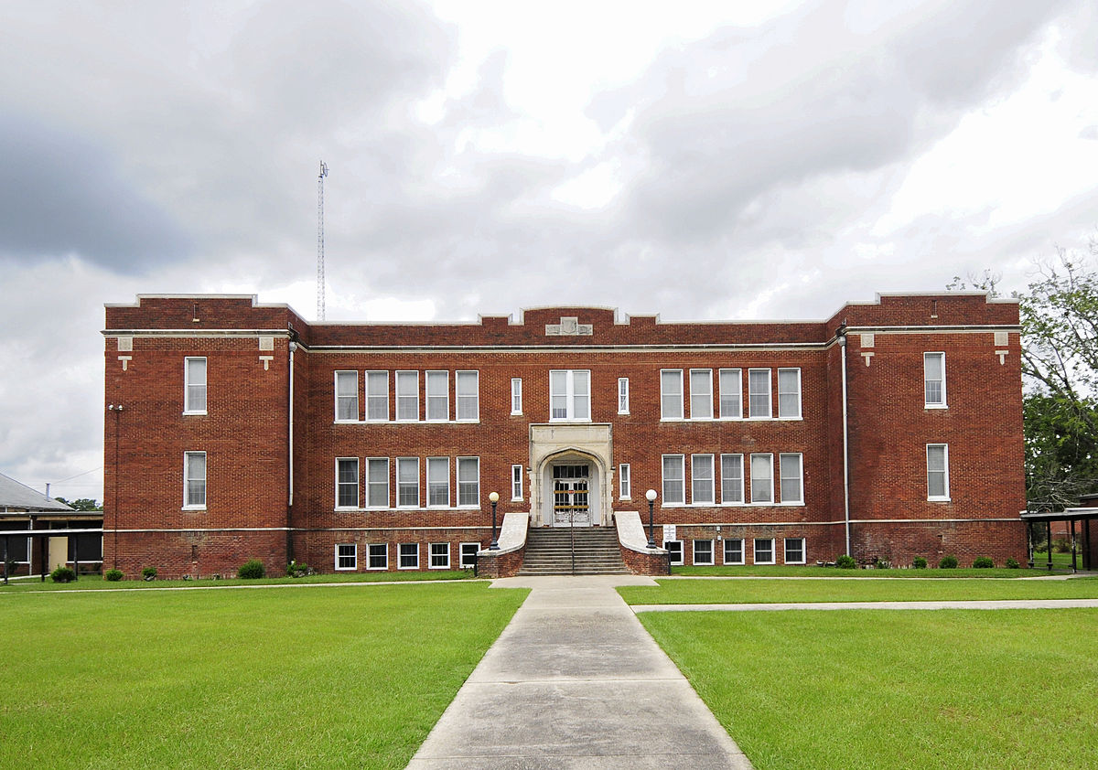
Building conditions survey
Education Law §3641 was amended by the State Budget legislation (Ch. 59 of the Laws of 209) to allow for the staggering of building condition surveys over a five-year period, beginning January 1, 2020. Prior law required all districts to submit survey every five years at the same time.
Commissioner is required to enact regulations establishing a schedule that evenly distributes surveys throughout the five-year period and ensuring that no region of the State is over-represented in any given year.
Priority must be given in the first two years to districts with the highest percentages of buildings with low condition ratings.

Slide 51
School Building Inspections
The State Budget legislation (Ch. 59 of the Laws of 2019) amended Education Law §409-d to require school districts to perform inspections at least once during the 2020 and 2022 calendar years, except for districts that are otherwise required to conduct a building condition survey (see previous slide) during that period.
Section 409-e was amended to eliminate the annual inspection requirement and to permit the Commissioner to order inspections as deemed necessary.
Effective June 30, 2019.

Slide 52
Transportation contracts
This year’s State Budget legislation (Ch. 59 of the Laws of 2019) added a new provision to Education Law §305(14) to allow districts to enter into a contract with another school district to provide student transportation even if the other district is using a private contractor.
A district can now “piggyback” on the contract if the BOE finds that it is appropriate and will result in savings to the district.
A “piggyback contract”:
Provides transportation to a location outside the student’s school district of residence, to which the other district is already transporting its own students;
Is entered into by the private contractor with each school district involved; and
Provides transportation in accordance with the terms of an existing contract.

Slide 53
Stop-arm cameras
On August 6, 2019, new legislation was enacted, effective September 5, 2019, authorizing the installation and use of cameras on the “stop arms” of school buses (Ch. 145 of the Laws of 2019).
The Vehicle and Traffic Law has been amended to authorize the issuance of fines for motorists who illegally pass school buses and who are photographed by the cameras.
The law allows a school district board of education, in its discretion, to pass a resolution authorizing the entry into a memorandum with a local government authority (e.g. city, town, or village within the school district) to enable the implementation of the law. School districts will not have access to the images, instead they must establish protocols with the municipality for the proper handling, custody and forwarding of the images from the cameras to the municipality for the purpose of determining whether or not a vehicle was operated in violation of the VTL and imposing a monetary fine.
The cost of the cameras is to be borne by the municipality.

Slide 54
Financial Transparency
ESSA requires that beginning with data from the 2018-19 school year, State Report Cards must include data on the per-pupil expenditures of federal, state and local funds, disaggregated by source of funds and for each school district and school in the State.
Fall 2019: open submission period for school districts to submit data.
Spring 2020: final ESSA Financial Transparency reports due and published
Note - State Transparency Budget Reporting required for all school districts by August 2020.

Slide 55
Retirement Contribution Reserve FUND
This year’s State budget legislation (Ch. 59 of the Laws of 2019) amended GML §6-r to authorize a BOE to establish (without voter approval) a Retirement Reserve Sub-Fund within the Retirement Contribution Reserve Fund to:
Finance retirement contributions to the NYS Teachers Retirement System (TRS); and/or
Offset all or some of the amount deducted from the monies apportioned to the district under Education Law §521.

Slide 56
District superintendent salary cap
The cap applicable to the salaries of BOCES superintendents, which is tied to the 1992-93 salary of the Commissioner of Education, was amended by the State Budget legislation (Ch. 59 of the Laws of 2019).
Section 1950(4)(2) provides that for the 2019-20 school year and subsequent years, the salary of a DS shall not exceed:
106% of the salary cap applicable in the preceding school year, or
98% of that earned by the Commissioner in the 2013-14 state fiscal year, whichever is less.

Slide 57
Tax cap
The Tax Cap has been made permanent pursuant to this year’s State Budget legislation (Ch. 59 of the Laws of 2019 Part NNN §13 ).

Slide 58
Thank you for listening!
713451758-514

