Slide 1
Utilizing the EdCamp Model for District Wide Professional Development
Mark Secaur, Ed.D.
Deputy Superintendent
Hewlett-Woodmere Public Schools
LIASCD Fall Conference
October 4, 2019

Slide 2
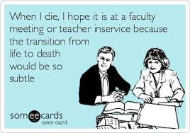
Philosophical Approach
Movement Away from One Size Fits All
Participant-driven PD
Provide Options
Develop Teacher Leadership & Desire to Share with Colleagues
Cultural Shifts Take Time
Models
Workshop
EdCamp
Hybrid

Slide 3
Culture Shift
Key Factors
Trust
Forum for Planning/Dialogue
Teacher/Administrator Buy In
Patience
Potential Results
Focused Learning
Development of Teacher-Leaders
Better Teacher/Administrator relationships
Better Integration of New Tools/Strategies into Teacher Practice

Slide 4
Workshop Model
Room | Session 1 (9:00-10:30) | Session 2 (10:40-12:10) | Session 3 (1:20-2:50)
LC 11 | Beyond Google Classroom: Extensions for Student Success- Universal Design | Kurzweil 3000 & Firefly Experience (Intermediate) | Beyond Google Classroom: Extensions for Student Success- Universal Design
101 | Makerspace 101 | Makerspace 101 | Makerspace 101
104 | Unpacking TERC: Kindergarten | Unpacking TERC : 2nd Grade | Creating Presentations w/Nearpod
105 | Unpacking TERC :4th Grade | Unpacking TERC: 3rd Grade | Integrating Digital Storytelling
106 | TERC Second Grade Workshop | TERC Fourth Grade Workshop | TERC Kindergarten Workshop
107 | TERC Third Grade Workshop | TERC Fifth Grade Workshop | TERC First Grade Workshop
109 | Microsoft Office and Outlook 365 | Microsoft Office and Outlook 365 | Microsoft Office and Outlook 365
121 |  | Nearpod for ELL | Differentiation and Assessment with Nearpod
123 | Classroom Teq for Geometry | Classroom Teq for Algebra 1 | Classroom Teq for Alg 2 / PreCalc
125 | ENL in the Pre-K Classroom | Special Education Data Tracking | Pre-K CLI Engage e-learning/ Mclass Circle Assessment
127 | Castle Learning: Level One | Castle Learning: Level Two | Castle Learning: Level Two
201 | MS Math Vertical Articulation | MS Math Vertical Articulation
207 | Unpacking TERC: 1st Grade | Classroom Management | The NYS Seal of Biliteracy
208 | Math/Google Classroom | HS Math Vertical Articulation | Nearpod in Secondary Math
219 | Engaging Secondary Science Students in Argumentation | 3 Dimensional Teaching and Learning (Secondary Science) | Incorporating Engineering in Secondary Labs and Lessons
222 | Unpacking TERC: 5th Grade | Come Sail Away: Scientific Inquiry and Engineering Design | Navigating 5th Grade Science Departmentalization
227 | Making the Most of Co-teaching | Geometry Collegial Circle
230 | Poetic Possibilities | Using EDpuzzle and Google | Beyond the Five Paragraph Essay
234 | Bringing Office 365 and Google Integration together with Edmodo | Seesaw Learning | Reading Eggs Webinar
238 | Google: Paperless Classrooms and Responsible Students | Google: Paperless Classrooms and Responsible Students | The Digital Classroom
239 | Creating Interactive Lessons with Notebook | Intermediate Lessons with Notebook and Smart Amp | Welcome to the New Smart Flat Panel Board
241 | Virtual Physics Labs | Explicit Strategy Instruction for Early Readers | Beautiful Me
243 | 2017-2018 Infinite Campus – Gradebook Set-up Instructions | 2017-2018 Infinite Campus – Gradebook Set-up Instructions | Google Docs 101 for Elementary Teachers
245 | Introduction to Video Conferencing | Introduction to Video Conferencing | Videoconferencing in the Elem. Classroom
246 | Practical Arts
247 |  | Managing Chromebooks in the Classroom with Dyknow Cloud | Managing Thinkpads in the Classroom with Dyknow Cloud
249 | Making Planning Easy with Planbook.com | Making Planning Easy with Planbook.com
253 | Getting Started with G Suite for Education | Google Classroom: Start to Finish | G Suite for Education for Beginner and Intermediate Users
Library | Crisis Prevention and Intervention
Little Theater | Special Education Law | Special Education Law | Dissecting the IEP
Yoga Room | Heartsaver® CPR/AED Instructor Certification
Orchestra Room | Orchestral Studies
Band Room | Band Studies
Chorus Room | Choral Studies
WMS: OEC | Introduction to the Outdoor Environmental Center (OEC) | Adv. Curriculum for the Outdoor Environmental Center (OEC) | Science Fairs at the Middle School Level
Old Model
Pre-Planned
Facilitators
Teachers
Administrators
3rd Parties
Sign up via My Learning Plan
PD Credit
Monitor Attendance
Logistics
Tech
Parking
Timing

Slide 5
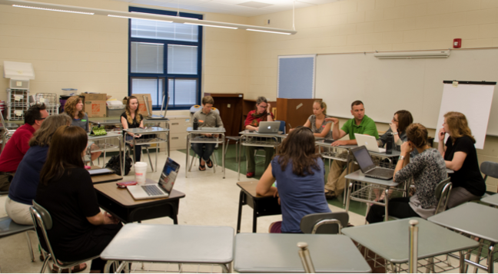
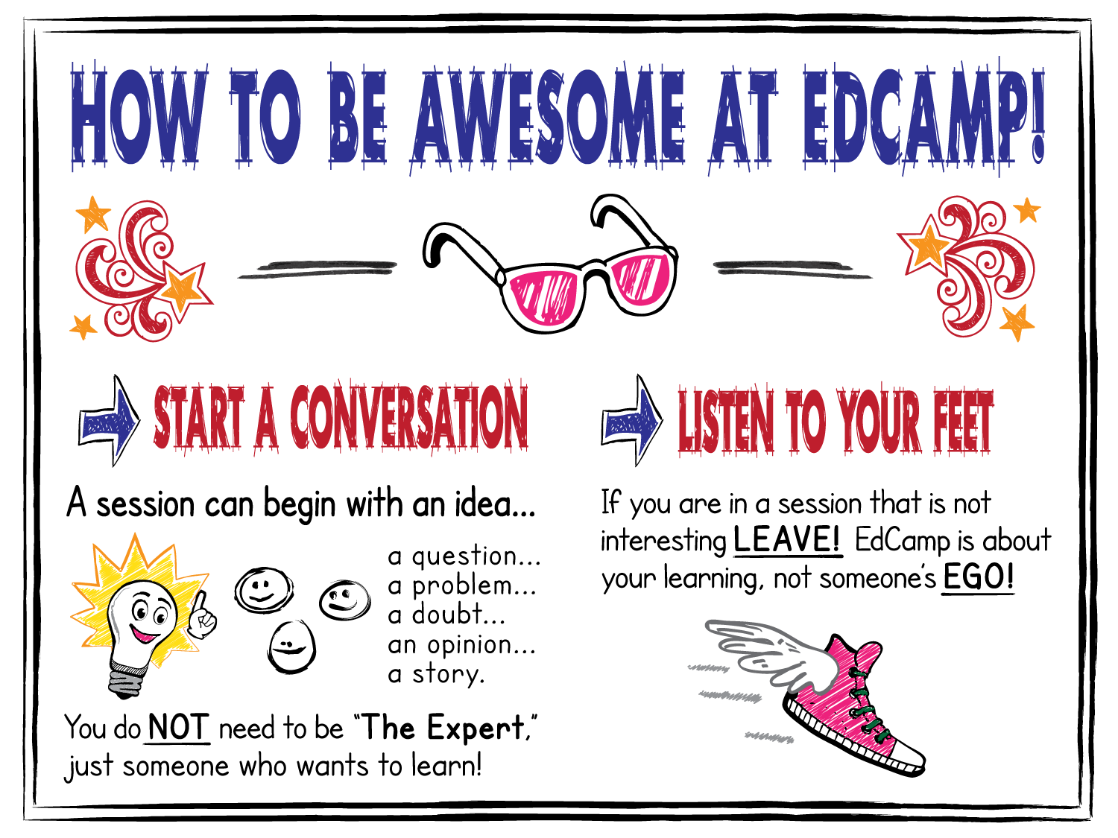
EdCamp Model
The Experts are In the Room!
Topics are Selected the Day of the Event
No Pre-Planned Workshops
Conversation, NOT Presentations
Staff Volunteer to Lead Sharing Workshops
Planning Session to Identify Workshops
Develop Session Board
Workshops
Chromebooks
Google Docs

Slide 6
Hybrid Approach: EdCamp 4.0
Melded the Workshop and EdCamp Models
Pre-Planned Workshops
Utilization of Padlet
Workshop Ideas on the Day of the Event
Session Board
Morning Sessions: HHS
Feedback
Sessions
Overall: Survey Data

